Slide 1
Real Estate Pricing Analysis
Exploring Data with Python
By Ankit Kashyap

Slide 2
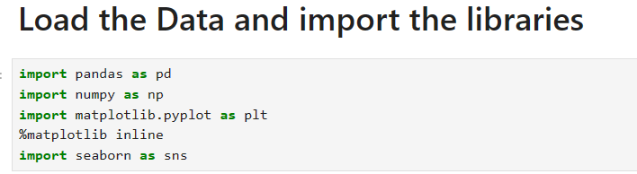
USED PYTHON LIBRARIES
Used libraries in data set:-
Pandas
Numpy
Matplotlib.pyplot
Seaborn

Slide 3
Loading the DataSet
Load the real estate pricing dataset into a Pandas DataFrame.
Load the dataset provided in a CSV or Excel format into a Pandas DataFrame to facilitate easy manipulation and analysis.
Ensure data quality by eliminating missing values, removing duplicate entries, and addressing any anomalies or inconsistencies in the dataset.

Slide 4
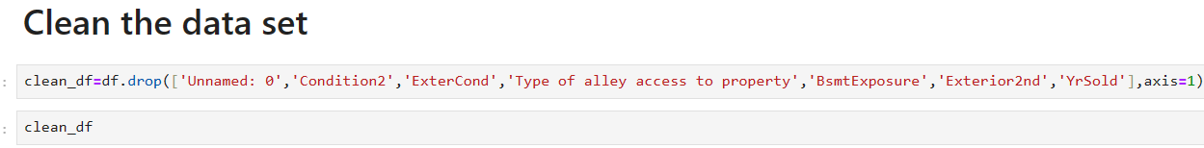
Cleaning the DataSet
Clean the dataset by handling missing values, removing duplicates, and addressing any anomalies.
Ensure data quality by eliminating missing values, removing duplicate entries, and addressing any anomalies or inconsistencies in the dataset.

Slide 5
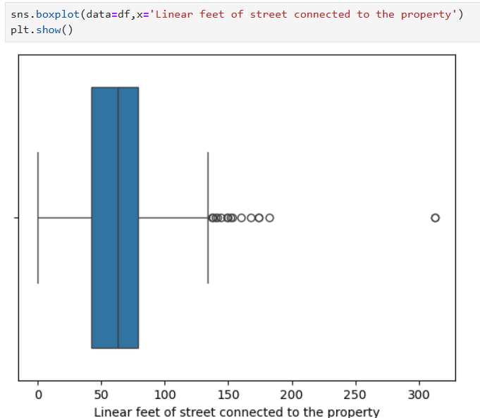
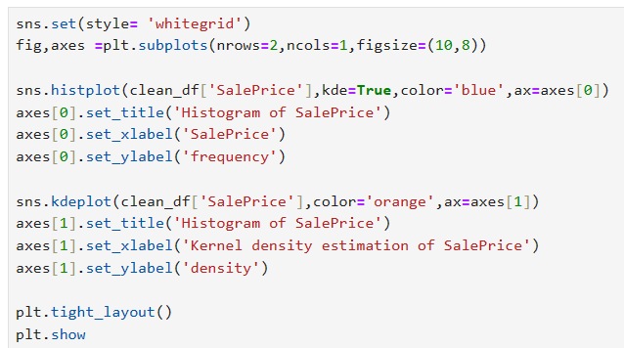
Univariate Analysis
Explore individual variables to understand their distributions and characteristics.
Conduct a univariate analysis to understand the distribution of key variables like house prices. Utilize histograms, kernel density plots, or other visualizations to gain insights into the data.

Slide 6
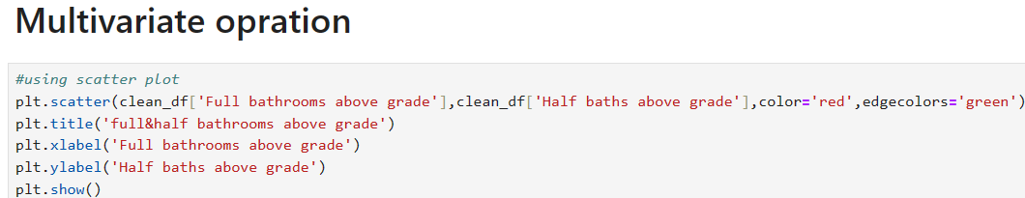
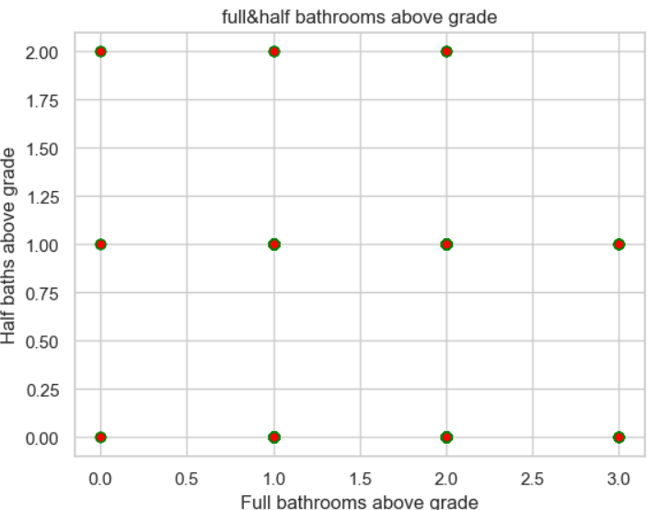
Multivariate Analysis
Investigate relationships between multiple variables, especially those impacting house prices.
Perform multivariate analysis to understand the correlations and dependencies between various features. Utilize techniques like correlation matrices or scatterplot matrices for a comprehensive view.

Slide 7
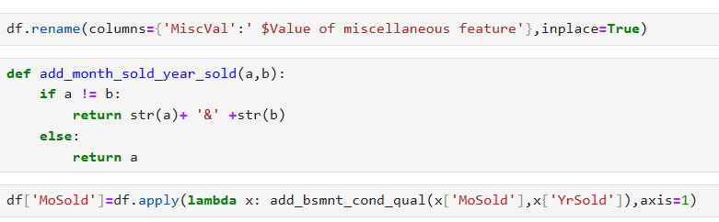
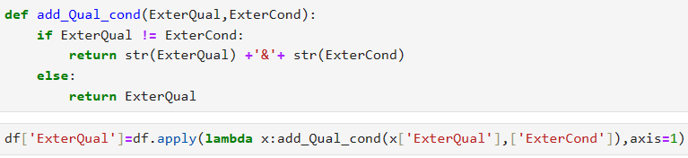
Feature Engineering and Size Impact
Further analyze the impact of features and size on house prices.
Explore relationships between key features (e.g., number of bedrooms, bathrooms, square footage) and house prices. Identify how these features collectively contribute to the valuation.

Slide 8
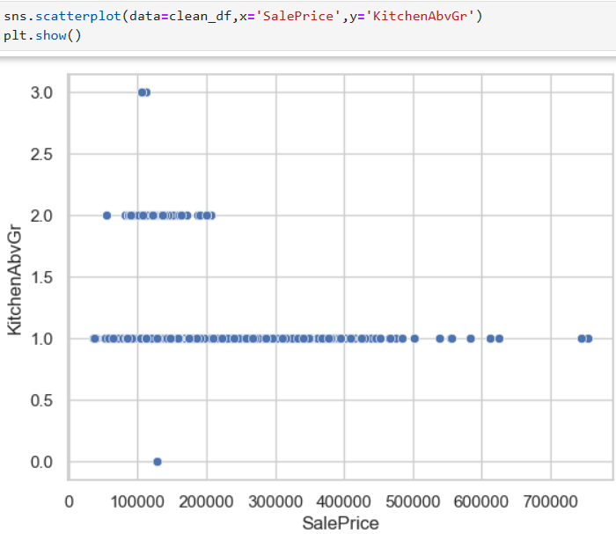
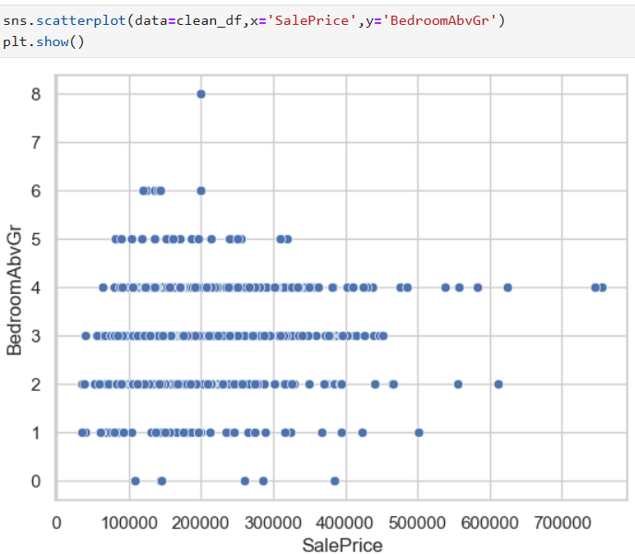
Market Trends and Historical Pricing
Explore historical pricing trends over time and understand market influences.
Analyze the dataset temporally, looking at trends in house prices over different periods. Understand how external factors, such as economic indicators, may have influenced these trends.

Slide 9
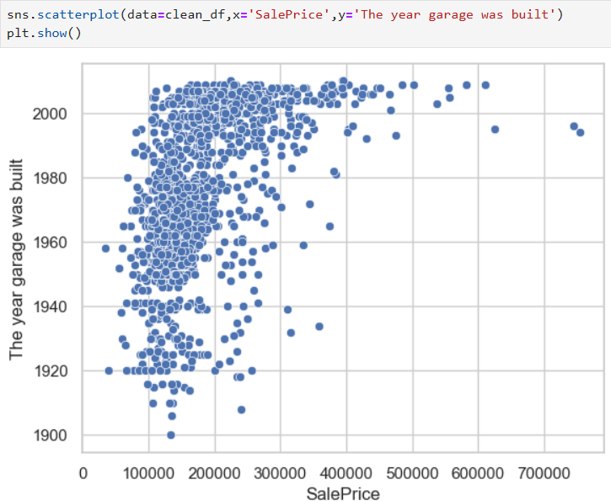
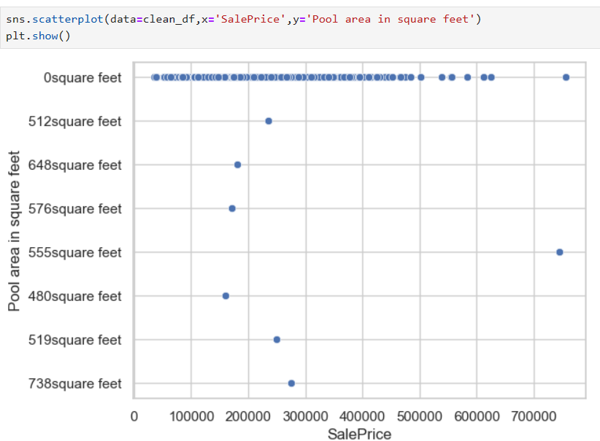
Customer Preferences and Amenities
Investigate how customer preferences and amenities impact house prices.
Examine the dataset to understand how specific amenities (e.g., swimming pool, garage) impact house prices. Analyze customer feedback or reviews to gauge the perceived value of these amenities.

Slide 10
Summary
Summary of key findings and insights from the analysis.
Recommendations or next steps based on the analysis.
Thank you

